Slide 1
Notes:
Image from: https://upload.wikimedia.org/wikipedia/commons/6/63/Monarch_In_May.jpg

Slide 2
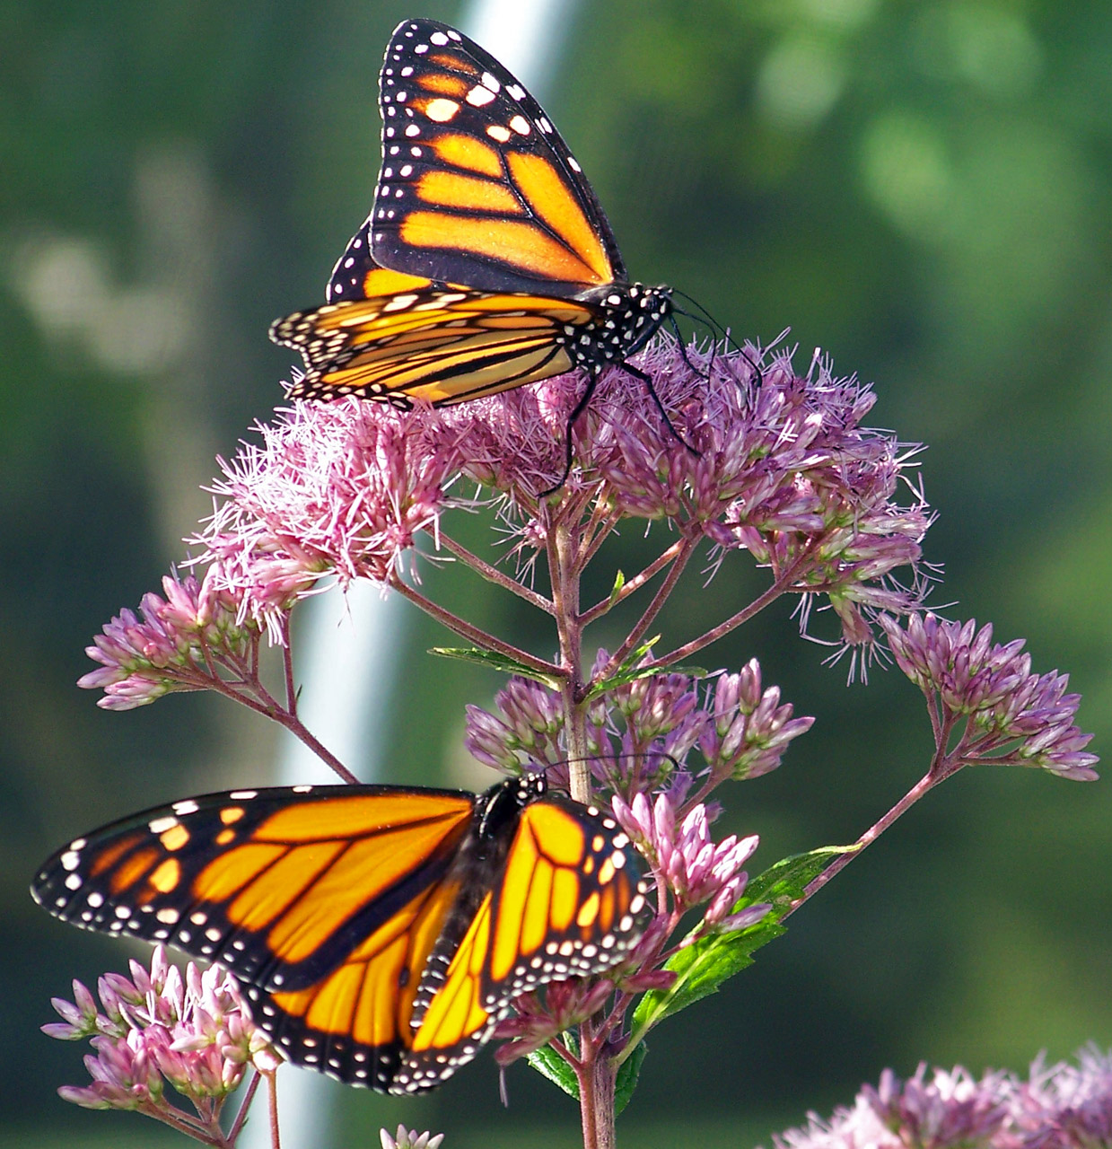
Monarch butterflies…
are insects.
have a wingspan of about four (4) inches.
weigh about one-fifth (1/5th) of an ounce.
Notes:
Top image from: http://www.publicdomainpictures.net/pictures/20000/velka/monarch-butterflies-on-a-flower.jpg
Bottom image from: https://upload.wikimedia.org/wikipedia/commons/b/b1/Monarch_butterfly_-_Butterfly_Place_in_Westford%2C_Massachusetts_%282%29.jpg

Slide 3
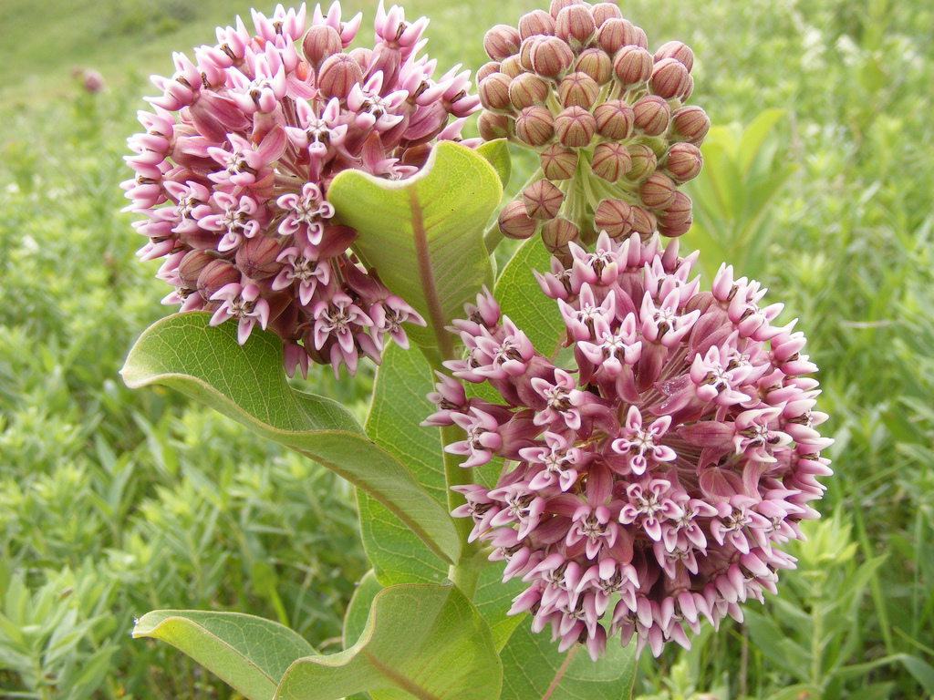
Notes:
Image from: https://c1.staticflickr.com/8/7331/9569973253_874975c839_b.jpg

Slide 4
Monarch butterflies rely on milkweed a common herbaceous prairie plant.

Slide 6
Milkweed… is the only plant monarch caterpillars can eat.

Slide 7
Monarch butterflies only lay eggs on the leaves of milkweed.
Females may lay up to 300 eggs!

Slide 8
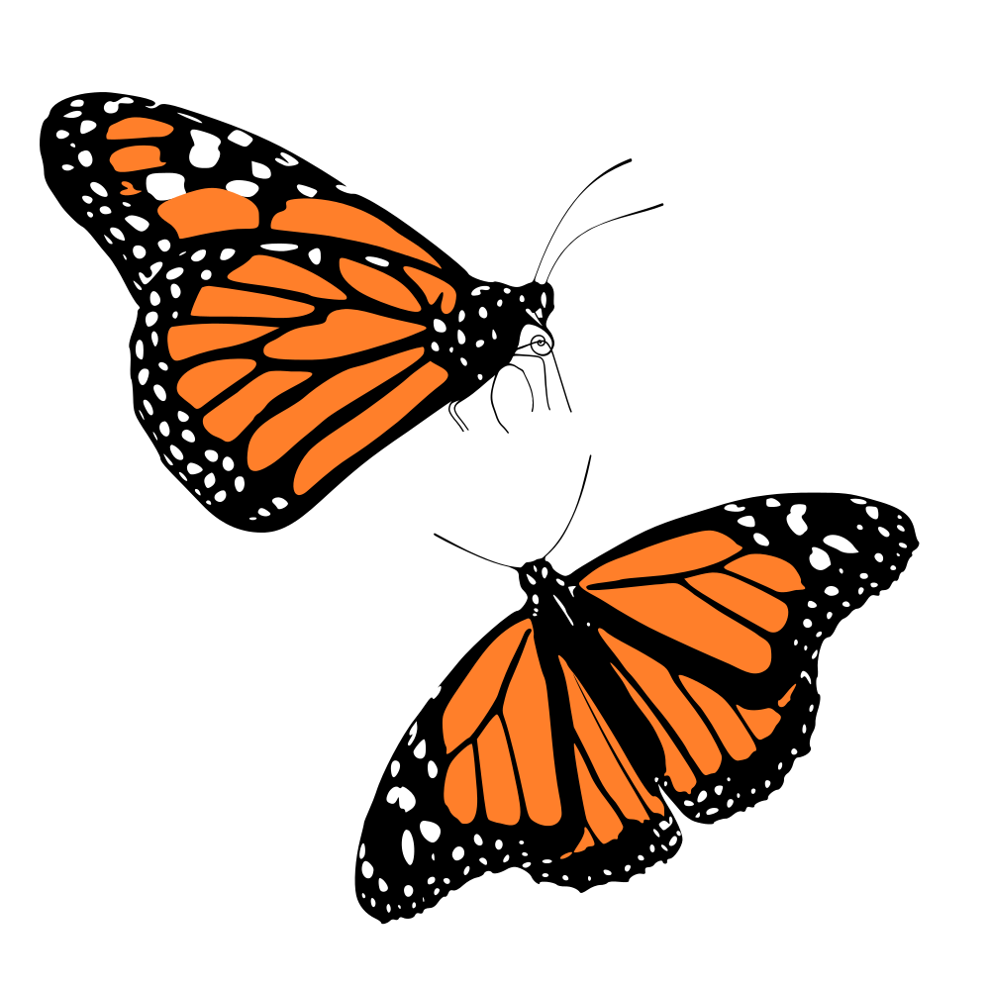
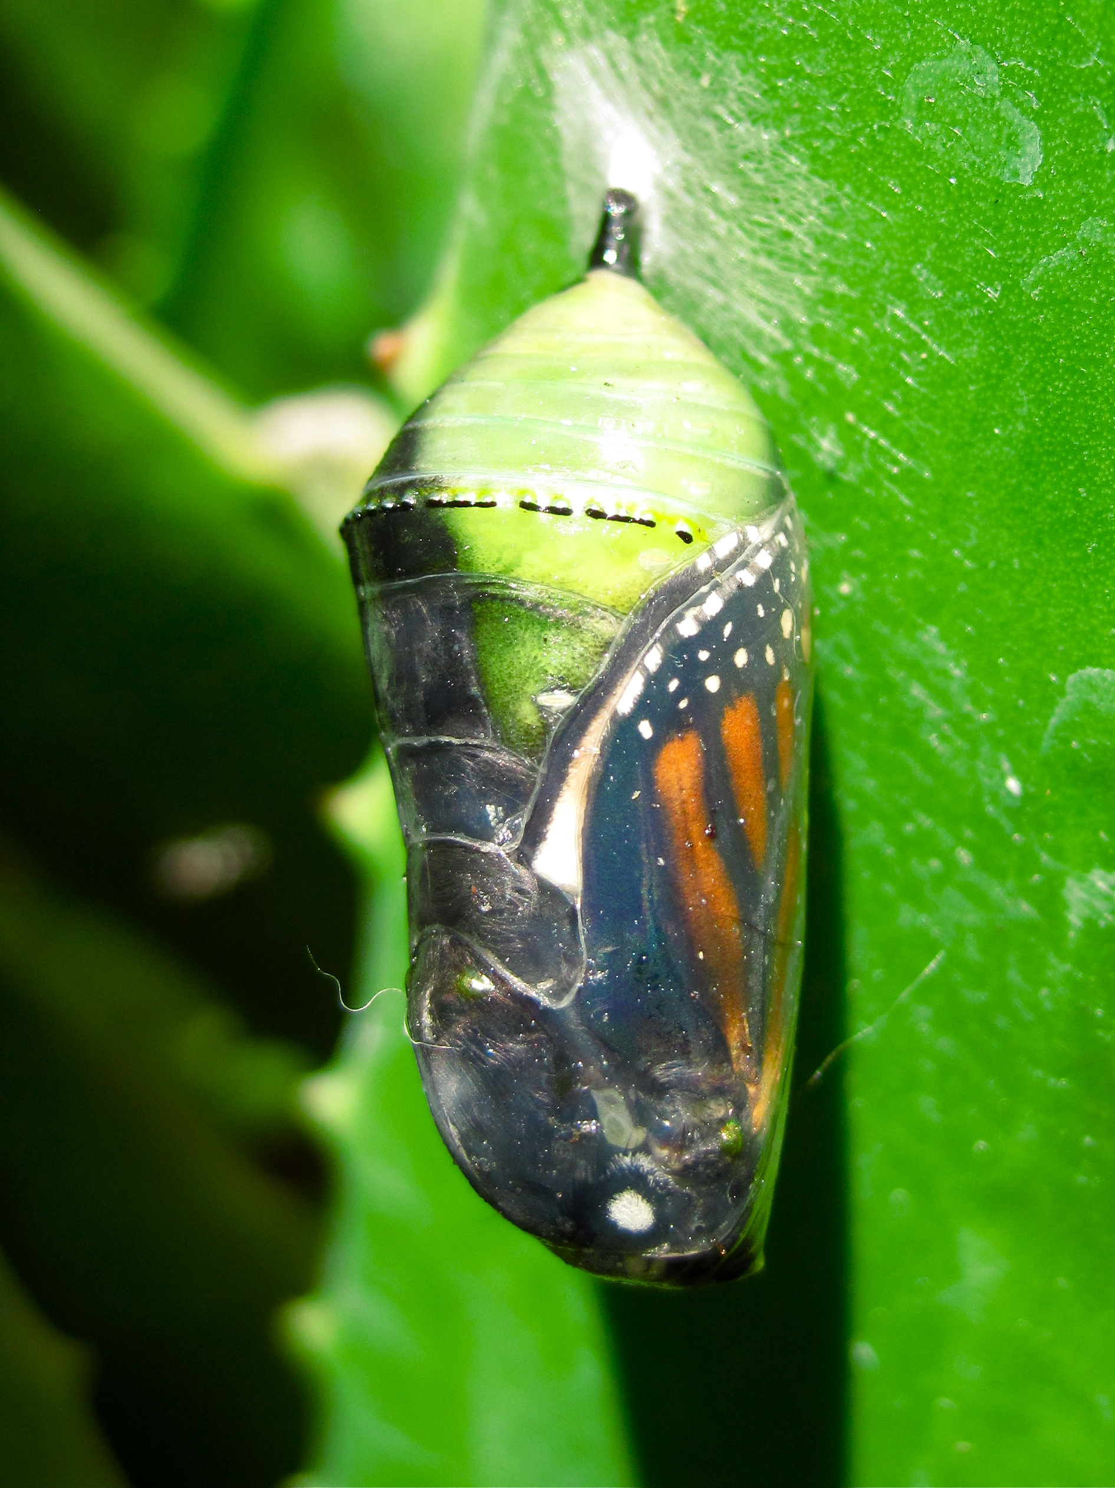
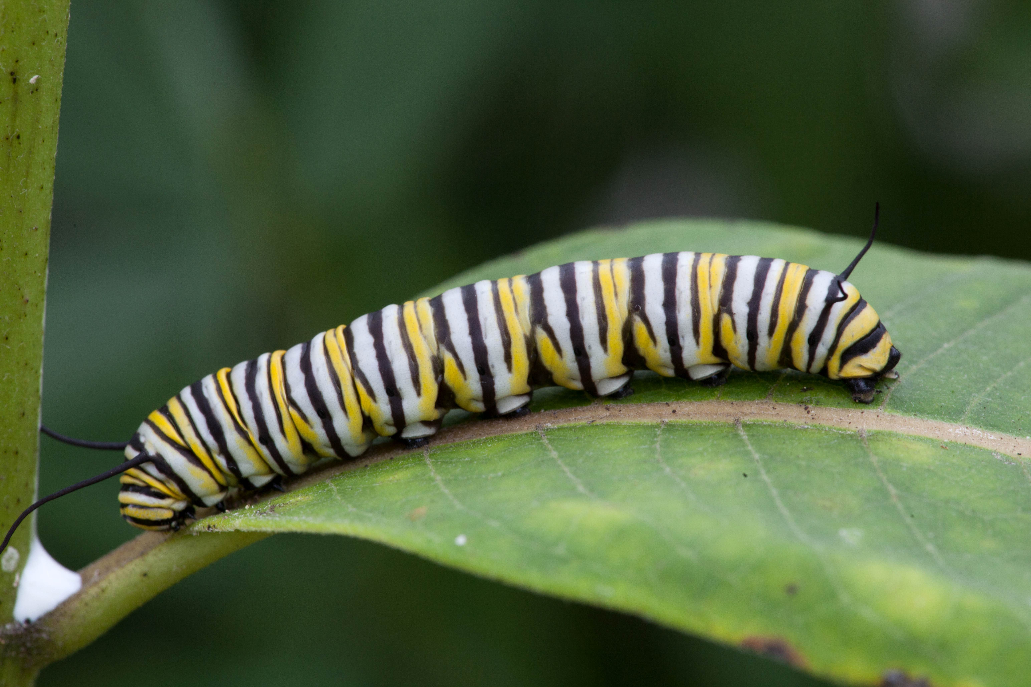
Monarchs develop in four stages:
egg
larvae (caterpillar)
chrysalis
adult butterflies
Notes:
Images from:
Egg: https://upload.wikimedia.org/wikipedia/commons/3/31/Danaus_plexippus%2C_Monarch_egg.jpg
Larvae: https://pixnio.com/free-images/2016/06/13/monarch-butterfly-larvae-feeding-milkweed.jpg
Chrysalis: https://upload.wikimedia.org/wikipedia/commons/2/2b/Monarch_Butterfly_%28Danaus_plexippus%29_Chrysalis.jpg
Adult butterflies: https://upload.wikimedia.org/wikipedia/commons/thumb/c/c6/Franzi_-_Monarch.svg/1000px-Franzi_-_Monarch.svg.png

Slide 9
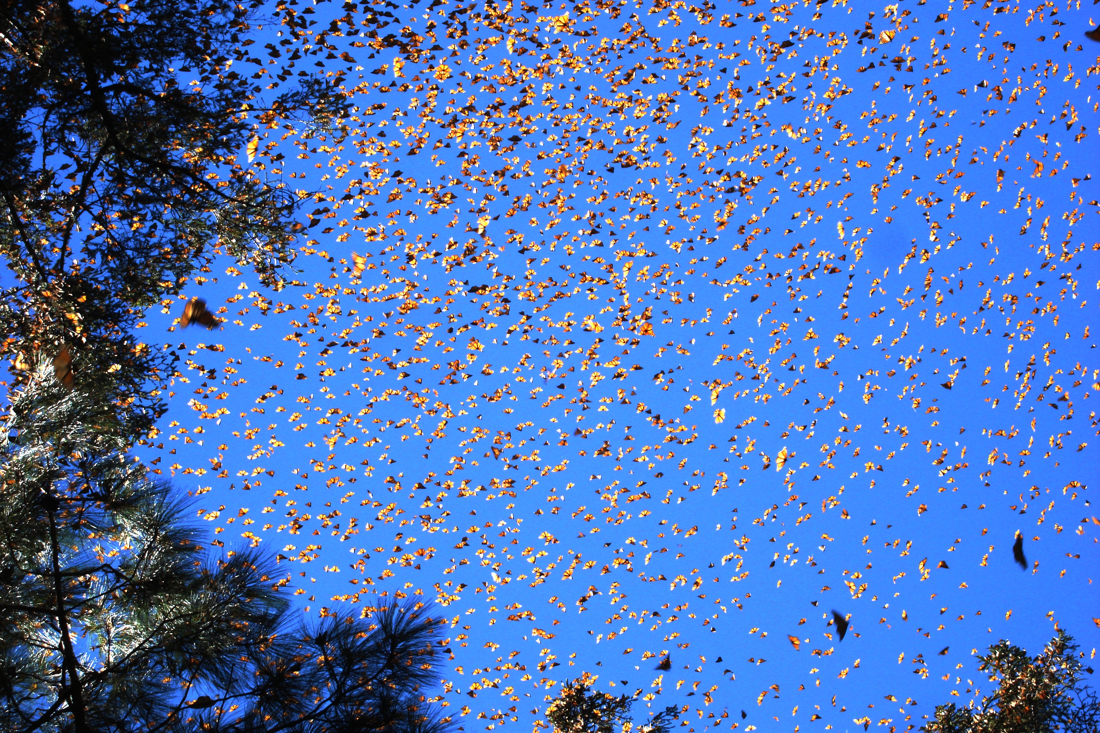
Notes:
Image from: https://upload.wikimedia.org/wikipedia/commons/2/29/Danaus_plexippus-1.jpg

Slide 10
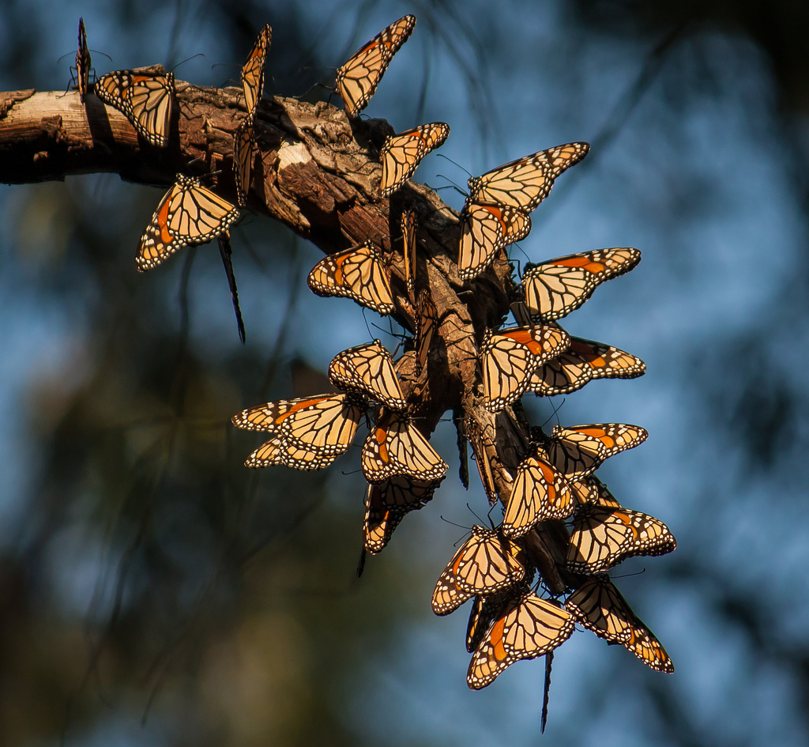
Millions of monarch butterflies migrate each fall, traveling from Canada to central Mexico, a distance of 2,000 miles.
Notes:
Image from: https://c1.staticflickr.com/9/8205/8232791398_3b67dbfb92_b.jpg

Slide 11
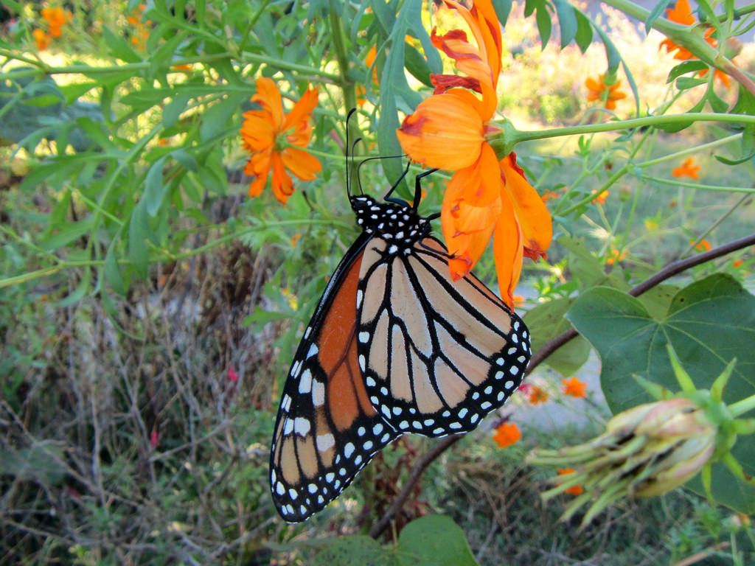
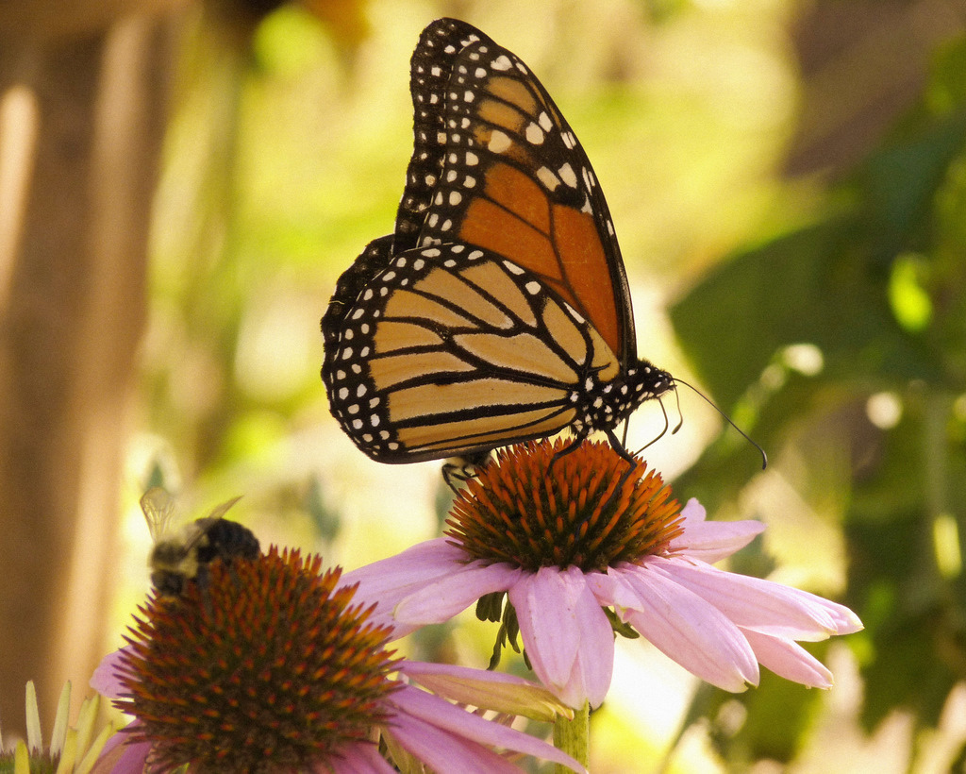
Adult butterflies eat nectar, and store the sugars as fat for the journey south.
Notes:
Top image from: https://c1.staticflickr.com/6/5661/30182894600_1c68d7c5dc_b.jpg
Bottom image from: https://c1.staticflickr.com/7/6059/6261067854_7cc33fb4d3_b.jpg

Slide 12
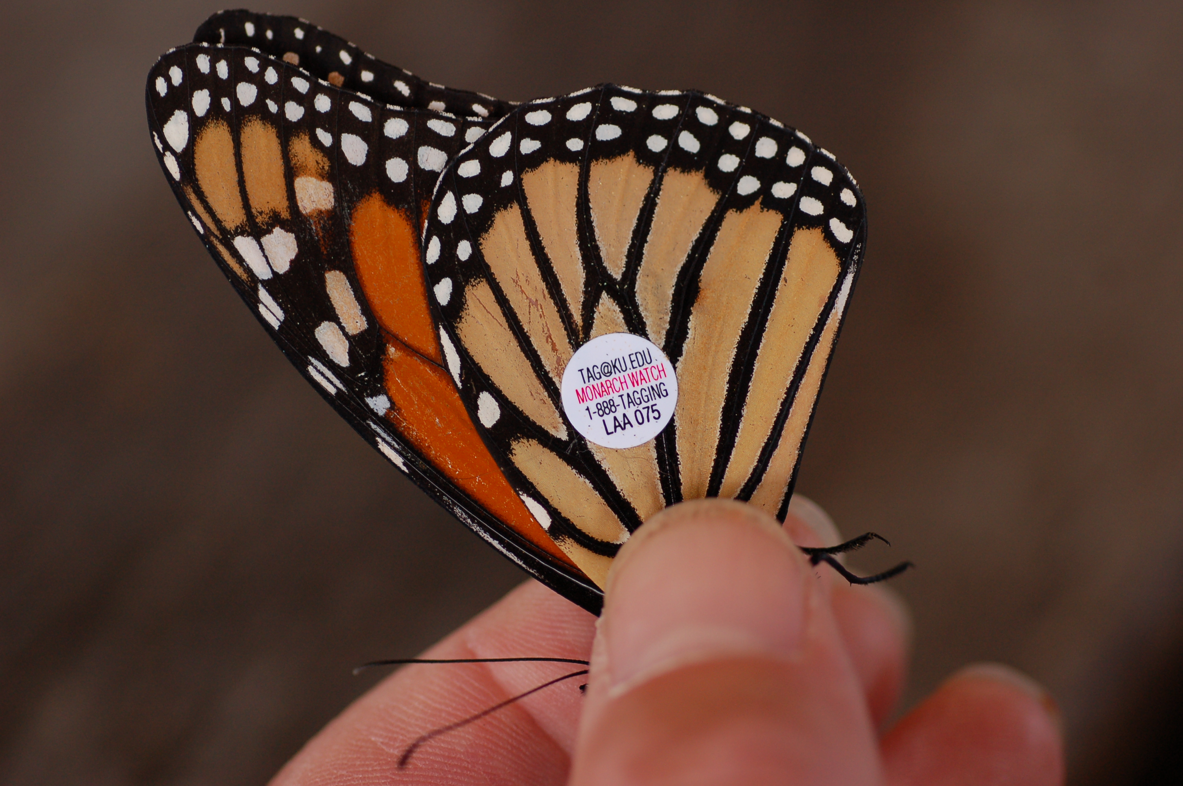
Scientists figured out the migration pattern of monarchs by tagging these butterflies.
Notes:
Image from: https://upload.wikimedia.org/wikipedia/commons/c/c3/Monarch_Butterfly_Danaus_plexippus_Tagged_Closeup_3008px.jpg

Slide 13
The generation of butterflies that flies south has never been to Mexico.
No one quite knows how the butterflies find their way!

Slide 14
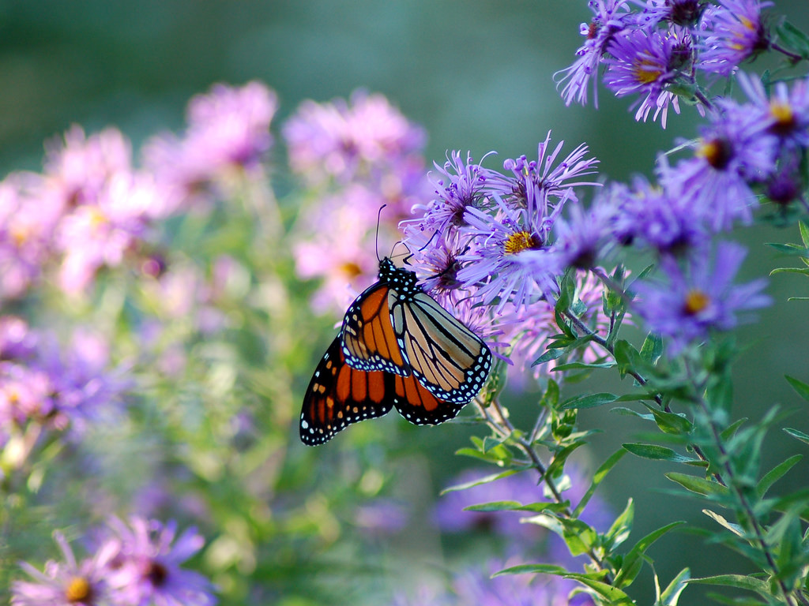
Maybe they…
track the position of the Sun.
navigate using landmarks.
align with Earth’s electromagnetic field.
Notes:
Image from: https://c1.staticflickr.com/1/79/265512944_2d06ff3b58_b.jpg

Slide 15
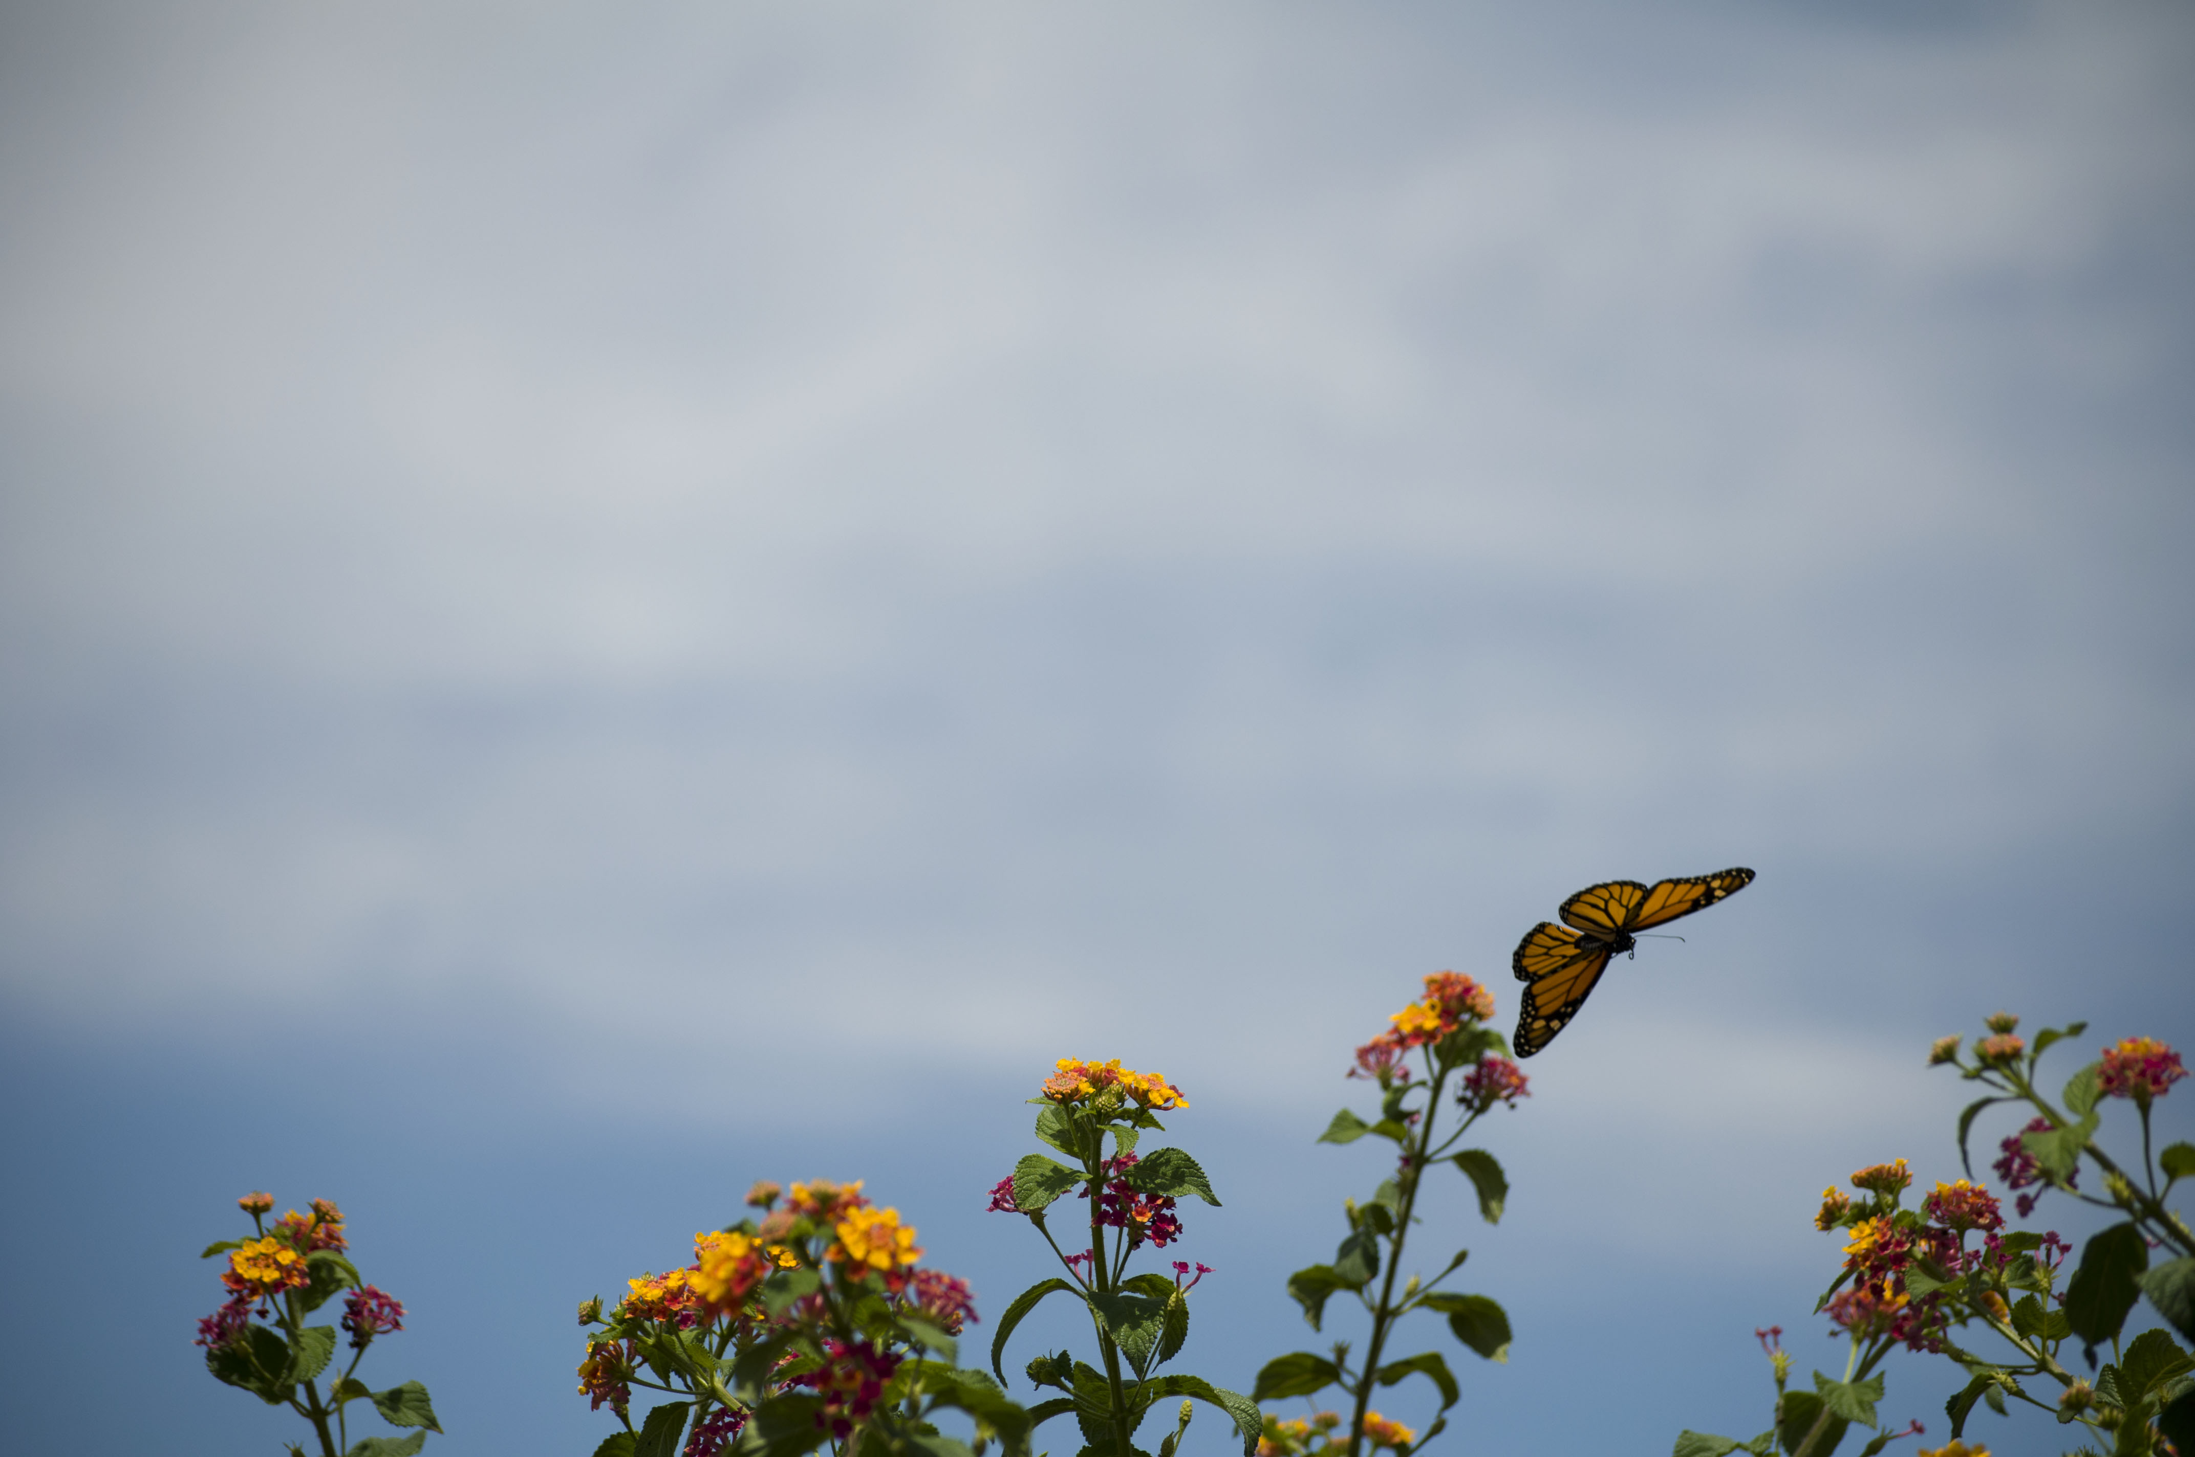
The butterflies fly 50 miles per day, avoiding storms and predators.
Notes:
Image from: https://upload.wikimedia.org/wikipedia/commons/9/9c/Monarch_Butterfly_-_Flying_%285882300521%29.jpg

Slide 16
Each fall, the monarchs arrive in mountain sanctuaries in central Mexico where they hibernate for the winter.
Notes:
Image from: https://upload.wikimedia.org/wikipedia/commons/2/21/Monarch-butterflies-pacific-grove.jpg

Slide 17
Threats to monarchs:
habitat loss
  deforestation
  loss of milkweed
climate change
herbicide and pesticide applications
Notes:
Top image from: http://www.publicdomainpictures.net/pictures/20000/velka/monarch-butterflies-on-a-flower.jpg
Bottom image from: https://upload.wikimedia.org/wikipedia/commons/b/b1/Monarch_butterfly_-_Butterfly_Place_in_Westford%2C_Massachusetts_%282%29.jpg

Slide 18
How can you help?

Slide 19
Plant milkweed.
Build a garden specially designed for butterflies and other pollinators.
Don’t use herbicides or pesticides.
Reduce your carbon footprint.
Help scientists track monarchs.
Notes:
Images from:
Egg: https://upload.wikimedia.org/wikipedia/commons/3/31/Danaus_plexippus%2C_Monarch_egg.jpg
Larvae: https://pixnio.com/free-images/2016/06/13/monarch-butterfly-larvae-feeding-milkweed.jpg
Chrysalis: https://upload.wikimedia.org/wikipedia/commons/2/2b/Monarch_Butterfly_%28Danaus_plexippus%29_Chrysalis.jpg
Adult butterflies: https://upload.wikimedia.org/wikipedia/commons/thumb/c/c6/Franzi_-_Monarch.svg/1000px-Franzi_-_Monarch.svg.png

