Slide 1
Honey Bees and the Geometry of Hives

Slide 2
Notes:
Honey, the caramel-colored syrup we pour on top of our pancakes or use to sweeten our tea, is produced by a small insect: the honey bee.

Slide 3
Notes:
This is the most common type of honey bee in North America and the one most commonly cared for by beekeepers.

Slide 4
Notes:
Honey bees are yellow with black stripes. At less than an inch in length, these guys are tiny!

Slide 5
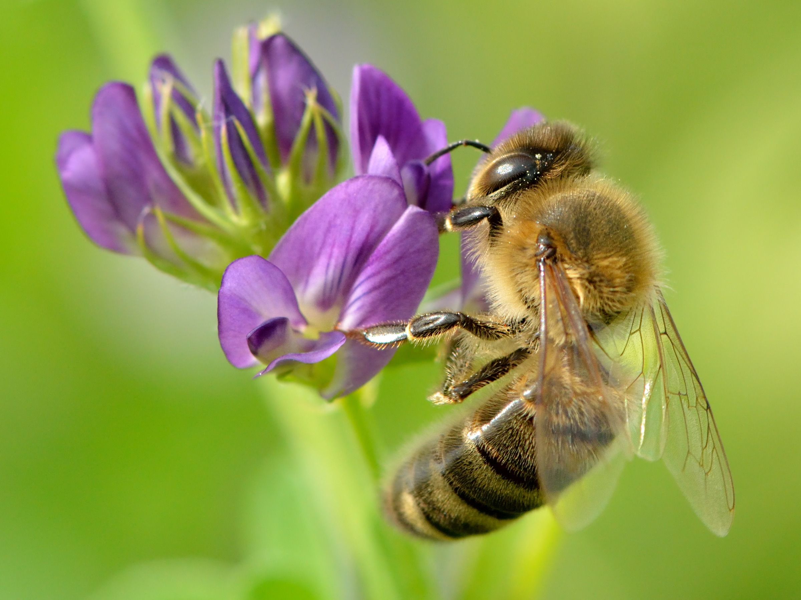
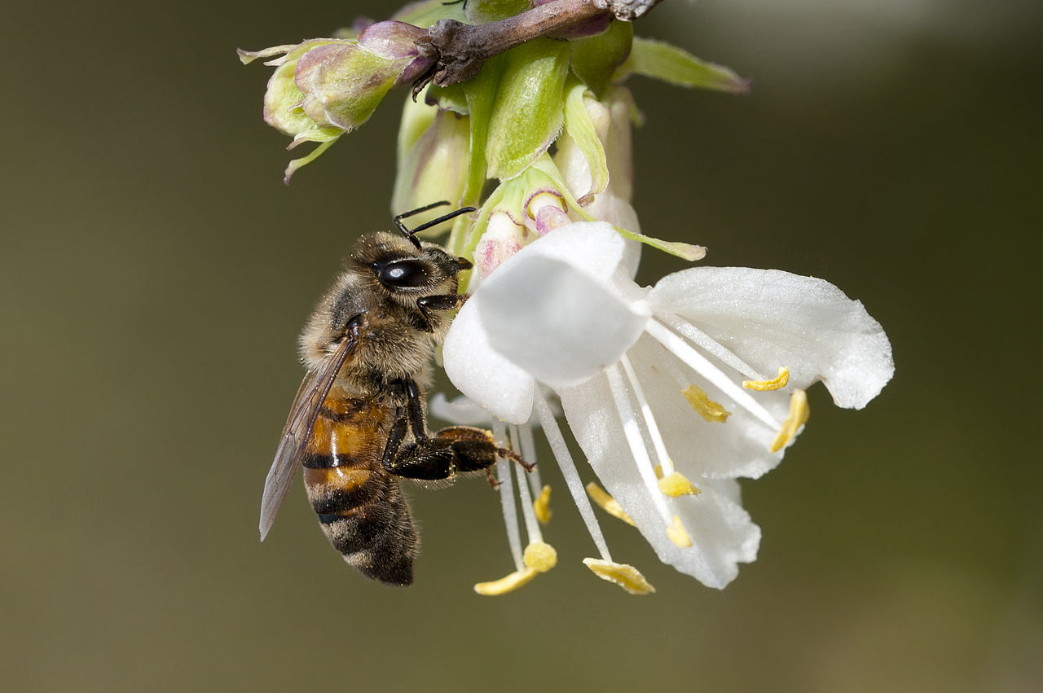
Notes:
Honey bees feed on nectar and pollen they collect from nearby flowers.

Slide 6

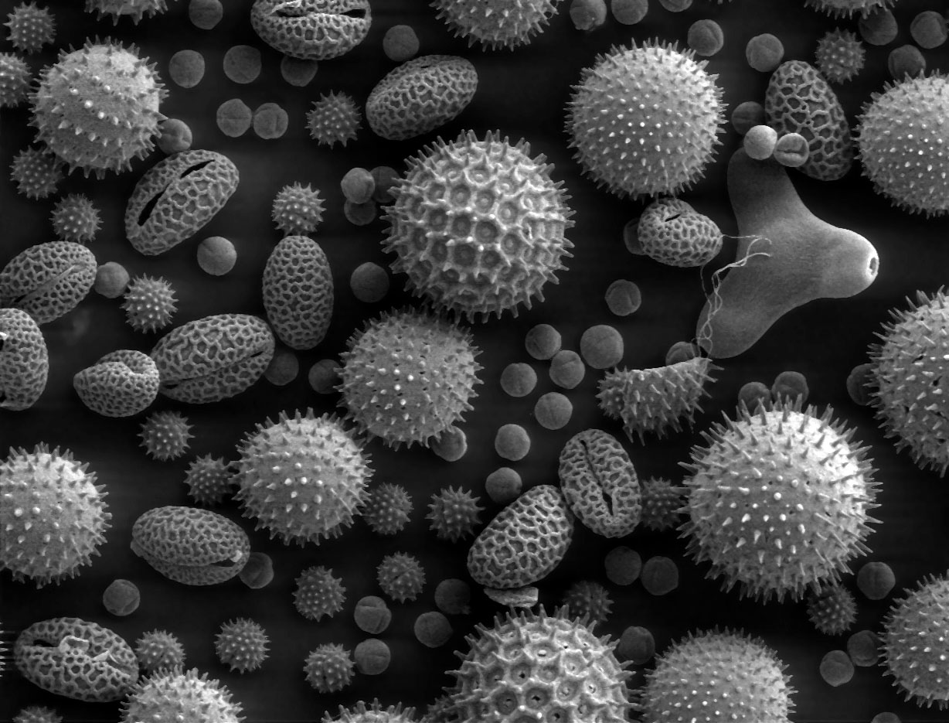
Notes:
While searching for food, honey bees collect much more nectar and pollen than they need to eat.

Slide 7
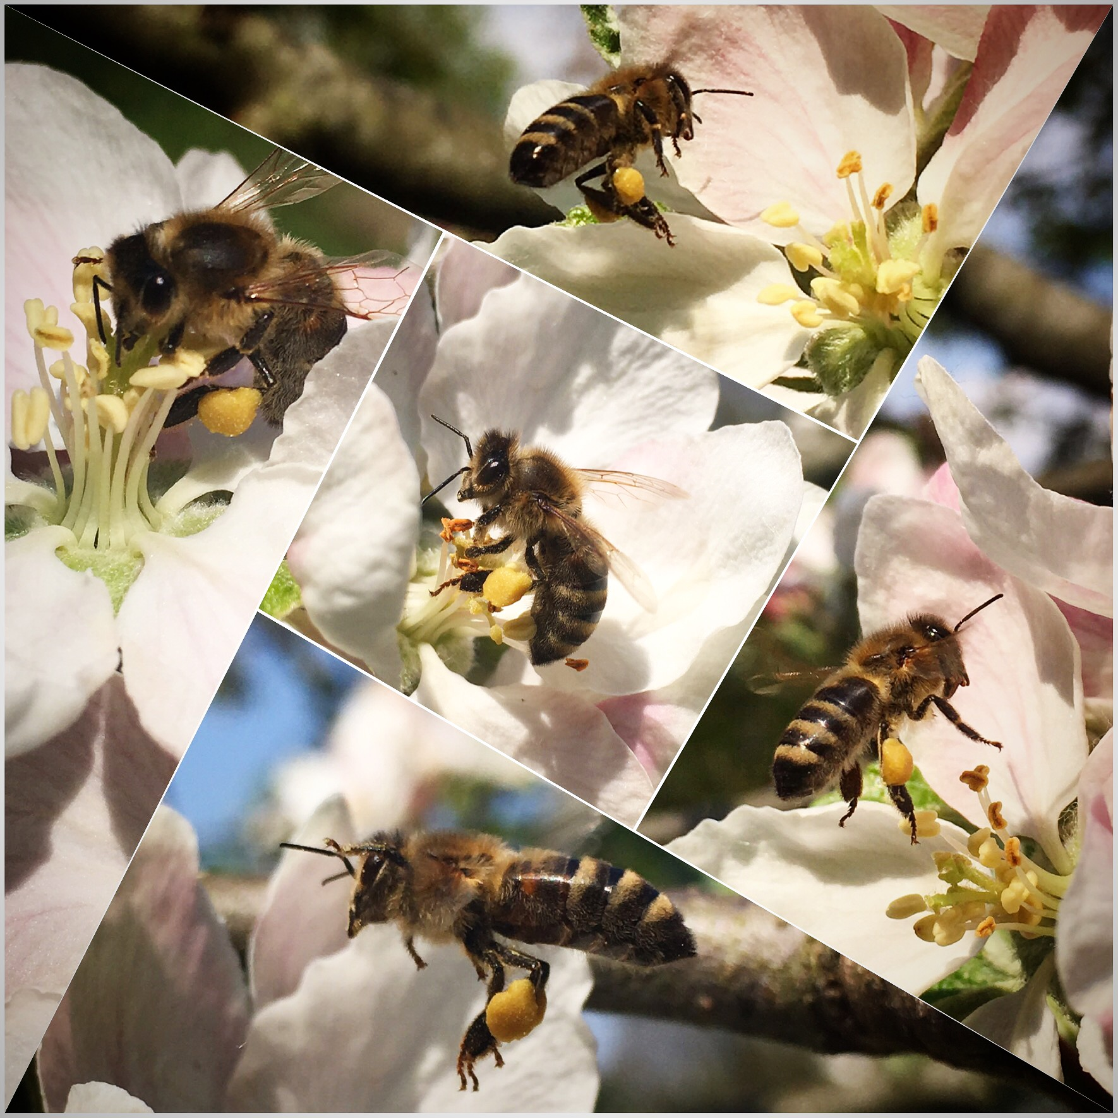
Notes:
The extra nectar is used to make honey. Honey is stored by bees to serve as a source of food during winter.

Slide 8
Notes:
Honey is produced and stored in bee hives.

Slide 9
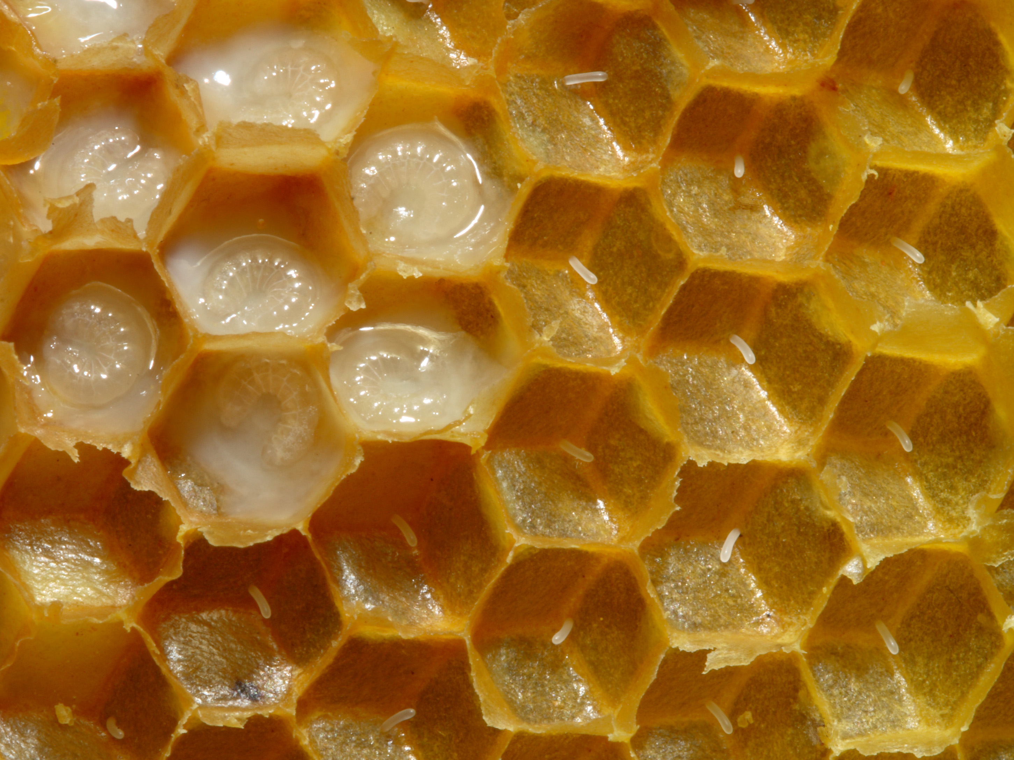
Notes:
Bee hives have a distinct shape. They are made from hexagon-shaped cells packed together.

Slide 10
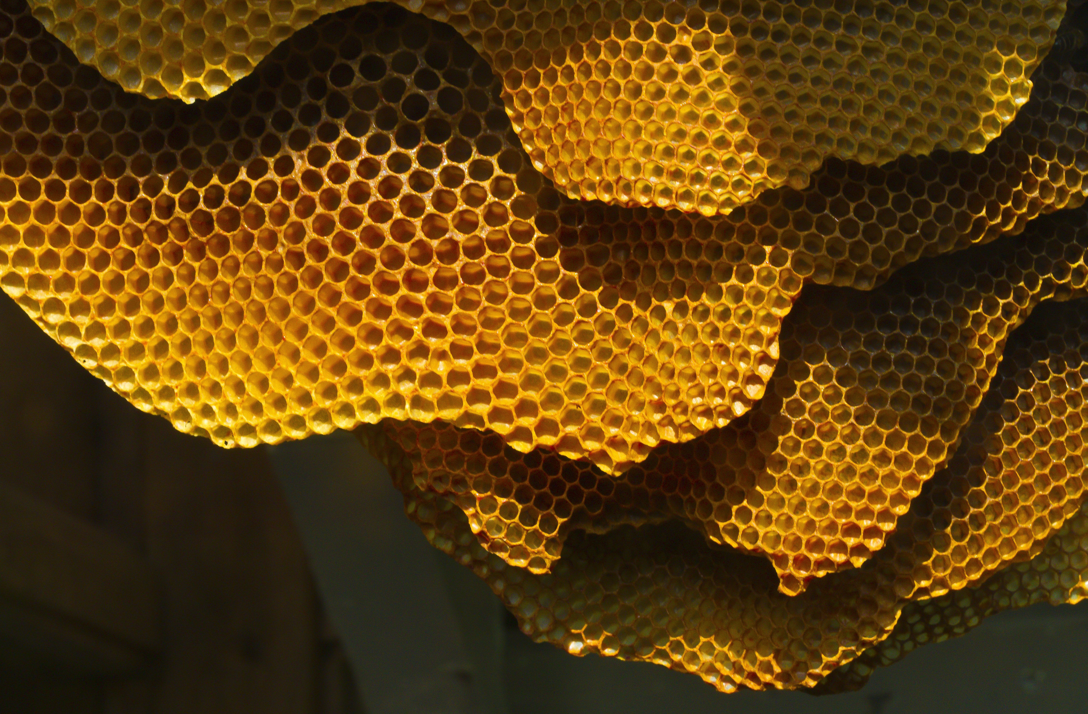
Notes:
Bee hives are super strong!

Slide 11

Notes:
We still have lots to learn about honey bee behavior. How do honey bees know how to build hives? Is it something they’re taught or something they have always known?

Slide 12
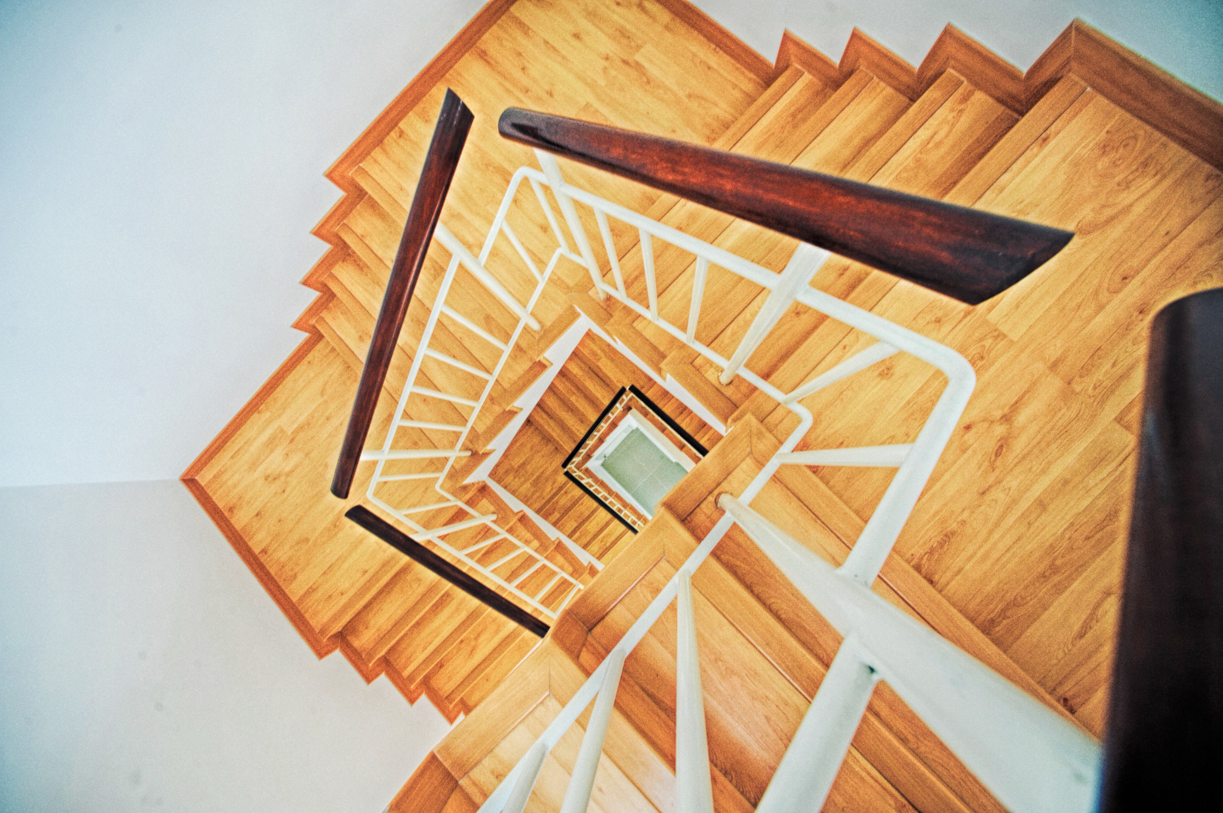


Notes:
Many engineers hope that by studying bees we will be able to build things that are just as strong as honey bee hives.

