Slide 1
A Dynamic Landscape
The Puget Sound region has been shaped by…
  glacial movement,
  volcanic eruptions,
  and earthquakes.

Slide 2
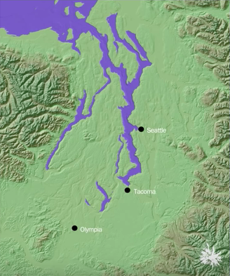
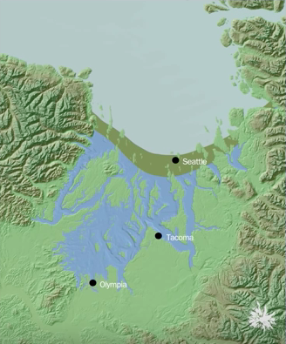
19,000 years ago
18,000 years ago
Notes:
Glacial Advance:
~ 19,000 years ago, a glacier to the north moved south into the Puget Sound region.
~ The sheet of ice advanced at a rate of about 450 feet per year.
~ The weight of the ice caused the land to sink. At the site where Pioneer Square is now located, scientists believe the glacier may have caused the land to sink by as much as 275 feet.
Photo downloaded from the Burke Museum’s website
https://www.youtube.com/watch?v=Dl2rObdNUFw

Slide 3
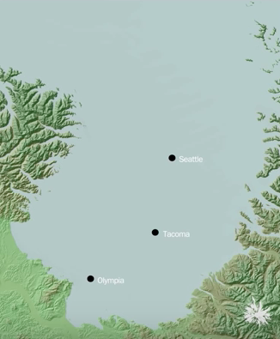
16,900 years ago
Notes:
Glacial Retreat:
~ The glacier reached its southernmost point about 16,900 years ago, then began to retreat northward.
~ The glacier retreated almost twice as fast as it advanced.
Photo downloaded from the Burke Museum’s website
https://www.youtube.com/watch?v=Dl2rObdNUFw

Slide 4
A New Landscape
During its advance and retreat, the ice sheet acted as a dam in the Puget Sound region, creating many of the freshwater lakes we see today.
The lowlands in the Puget Sound region were formed as land was eroded by meltwater from the glaciers.
Notes:
A New Landscape:
~ During its advance and retreat, the ice sheet acted as a dam in the Puget Sound region. This created many of the freshwater lakes we see today.
~ The lowlands in the Puget Sound region were formed as land was eroded by meltwater from the glaciers.
~ The land rose following retreat of the glacier, reaching its current elevation about 11,000 years ago.

Slide 5
The Duwamish-Green River Valley
The Duwamish-Green River Valley used to be a saltwater channel.
This channel was called the “Duwamish Embayment.”
Notes:
The Duwamish-Green River Valley:
~ The Duwamish-Green River Valley used to be a saltwater channel.
~ This channel was called the “Duwamish Embayment.”

Slide 6
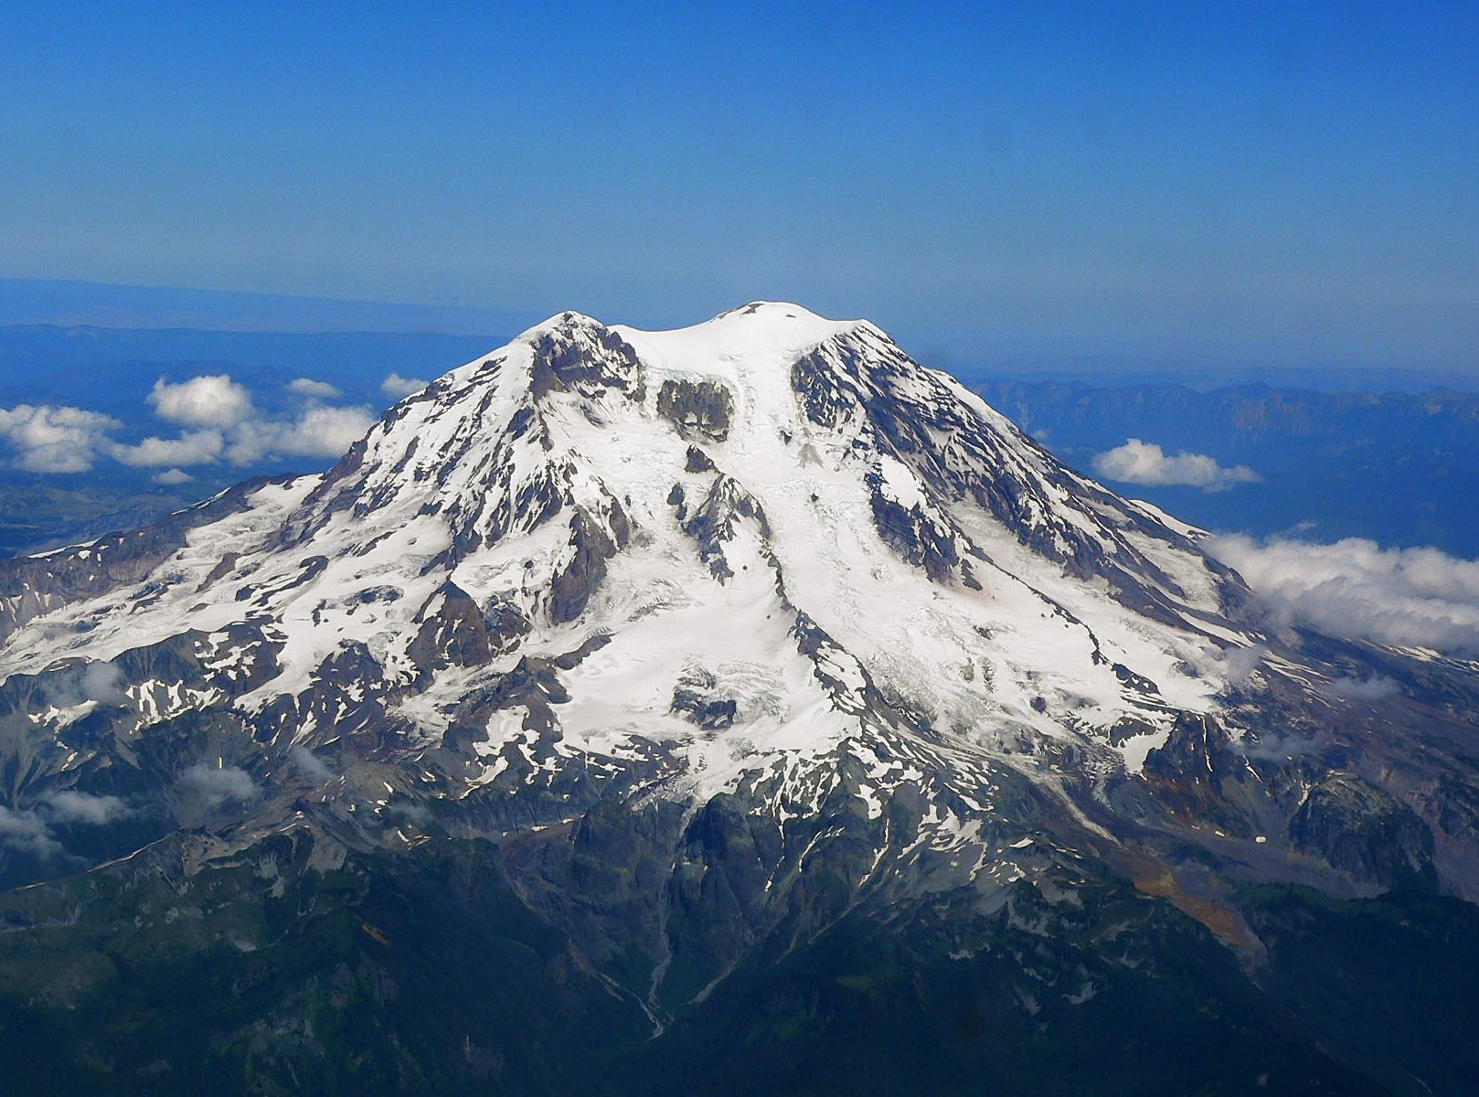
Mount Rainier
5,600 years ago, part of Mount Rainier collapsed.
2,200 years ago, Mount Rainier erupted.
Photo by Stan Shebs
Notes:
The Duwamish-Green River Valley:
~ 5,600 years ago, part of Mount Rainier collapsed. Volcanic debris flowed into the channel, creating a delta.
~ 2,200 years ago, Mount Rainier erupted. The resulting volcanic debris filled in the channel even more.
~ By about 800 A.D., the Duwamish Embayment was completely filled in.
Photo by Stan Shebs, downloaded from https://commons.wikimedia.org/wiki/File:Mount_Rainier_from_west.jpg

Slide 7
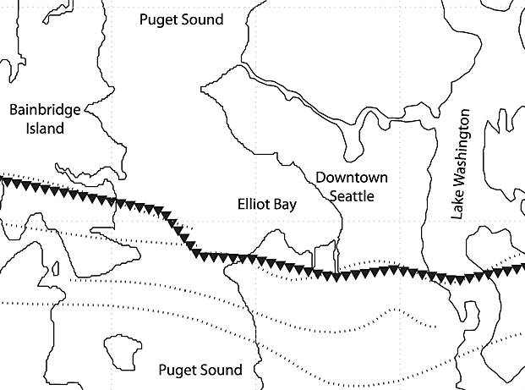
Seattle Fault
The valley was later raised about 20 feet by an earthquake that occurred about 1,100 years ago along the Seattle fault line.
Notes:
The Duwamish-Green River Valley:
~ The Duwamish-Green River Valley was later raised about 20 feet by a 7.0 magnitude earthquake that occurred about 1,100 years ago along the Seattle fault line.
~ This is the most recent earthquake to have occurred along this fault line. Scientists only recently discovered this fault line, in the early 1990s.
Photo downloaded from the University of Washington’s website
http://www.washington.edu/news/2013/10/22/study-quake-triggered-landslides-a-significant-hazard-in-seattle/

Slide 8
Thriving Ecosystems
For hundreds of years, the salt water marshes and tidal plains along the meandering Duwamish River supported a wide variety of wildlife.
The river was also of tremendous cultural importance to the Coastal Salish who have lived in Puget Sound region for thousands of years.

Slide 9
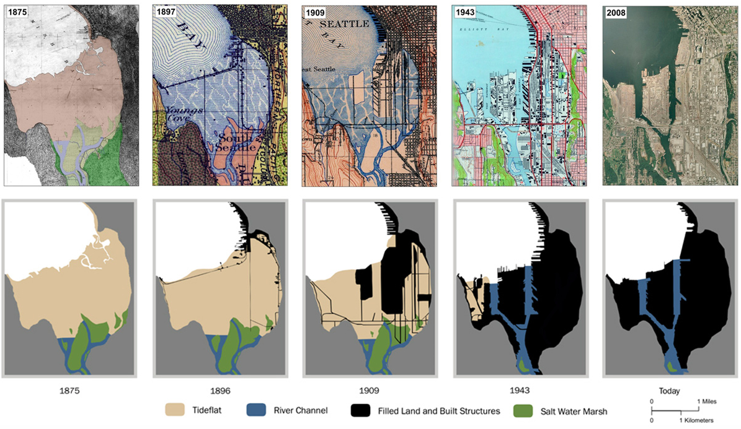
Notes:
Meanders No More:
~ In the early 1900s, humans began to transform the Duwamish River.
~ The Duwamish River was dredged and straightened to control flooding, make navigation easier, and support industrial development.
~ Rivers were diverted out of the Duwamish-Green River Valley. The Duwamish River itself was shortened by four miles.
~ Harbor Island was built from the dredged soil in 1909. At the time, this was the world’s largest manmade island.
Photo downloaded from the Burke Museum’s website
http://www.burkemuseum.org/static/waterlines/images/maps-and-images/Duwamish_estuary_fill_series.jpg

Slide 10
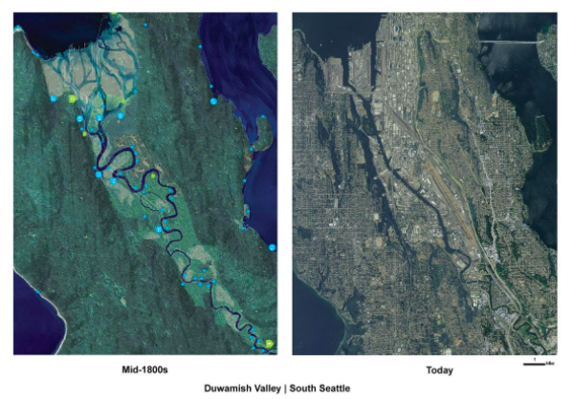
https://www.youtube.com/watch?v=8a3r-cG8Wic
Notes:
Meanders No More:
~ This image is from the Waterlines Project Map. According to the Burke museum, this map is “a rendering of the Seattle area in the mid-19th century, just prior to non-Native settlement, created using photorealistic aerial views collaged with hand painting. The map content integrates research from the sciences, natural and cultural histories, with an admixture of informed imagining.”
Ecosystem Consequences:
~ It is natural for rivers in lowland landscapes to meander. Their paths are not naturally channeled by rocks, like rivers that run through mountains.
~ Meandering streams provide essential habitat to a number of native species, such as salmon.
Photo downloaded from the Burke Museum’s website
http://www.burkemuseum.org/blog/duwamish-meanders-river-ran-through-it

Slide 11
Ecosystem Consequences
Channelization significantly alters river habitat.
Waters move more quickly through shorter, straighter, deeper rivers.
  Increased flow velocity may negatively impact aquatic organisms that have evolved to thrive in the slow-moving waters of meandering streams.
Notes:
Ecosystem Consequences:
~ Channelization significantly alters river habitat.
~ Waters move more quickly through shorter, straighter, deeper rivers.
~ Increased flow velocity may negatively impact aquatic organisms that have evolved to thrive in the slow-moving waters of meandering streams.

Slide 12
Ecosystem Consequences
2. Reduction of vegetation degrades habitats for aquatic and terrestrial organisms.
  Aquatic plants that live in shallow waters may not be able to survive in a channeled river.
  Channelization may also result in the removal of plants that lived along the banks of the river.
  Fish in particular often rely on vegetation to provide cool, safe hiding places.
Notes:
Ecosystem Consequences:
~ Reduction of vegetation degrades habitats for aquatic and terrestrial organisms.
~ Aquatic plants that live in shallow waters may not be able to survive in a channeled river.
~ Channelization may also result in the removal of plants that lived along the banks of the river.
~ Fish in particular often rely on vegetation to provide cool, safe hiding places.

Slide 13
Ecosystem Consequences
3. Waters also tend to be more polluted after being channeled, as there is little opportunity for sediments to settle.
  This damages fisheries and threatens other wildlife, including birds and mammals that live along the river.
Notes:
Ecosystem Consequences:
~ Waters also tend to be more polluted after being channeled, as there is little opportunity for sediments to settle.
~ This damages fisheries and threatens other wildlife, including birds and mammals that live along the river.

Slide 14

History of the Duwamish River
Notes:
Movie downloaded from the City of Seattle’s website
https://www.seattlechannel.org/CityStream/segments?videoid=x21250

Slide 15
Citations
Brooker, M. P. 1985. The Ecological Effects of Channelization. The Geographical Journal, 151(1), 63-69.
Burke Museum. 20,000 Years in Puget Sound. May 16, 2012. https://www.youtube.com/watch?v=Dl2rObdNUFw
Burke Museum. Duwamish meanders: A river runs through it. September 25, 2015. http://www.burkemuseum.org/blog/duwamish-meanders-river-ran-through-it
Burke Museum. The Waterlines Project Map. 2014. http://www.burkemuseum.org/static/waterlines/project_map.html
History Link. Harbor Island, at the time the world’s largest artificial island, is completed in 1909. November 6, 2001. http://www.historylink.org/File/3631
U.S. Environmental Protection Agency. National Management Measures to Control Nonpoint Source Pollution from Hydromodification. July 2007. https://www.epa.gov/sites/production/files/2015-09/documents/chapter_3_channelization_web.pdf

